Slide 1
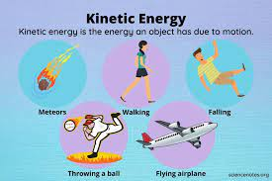
U1M2L1 Kinetic Energy
Mechanical Energy

Slide 2
Students are expected to: • Define kinetic energy • Discuss factors that affect kinetic energy • Relate to real life examples

Slide 3
Warm up

Slide 4
What causes motion?
When a marble hits a small ball , the ball moves.
This is a change in position caused by the motion of the marble . The change in motion of the small ball occurred because the marble had a form of energy.
Recall that energy is the ability to cause change.

Slide 5
Kinetic Energy
Kinetic energy (KE) is the energy due to motion.
All moving objects have kinetic energy.
If the object is not moving ( at rest ) , its KE is ZERO .
The kinetic energy of a moving object depends on two factors:
**the object’s speed ** and its mass

Slide 6
How are kinetic energy and mass related?
Kinetic Energy and Mass
Imagine holding two balls with different masses above a pan of modeling clay.
If you drop the balls from the same height, which ball will create the largest dent in the clay ?

Slide 7
How are kinetic energy and mass related?
Kinetic Energy and Mass
Imagine holding two balls with different masses above a pan of modeling clay.
If you drop the balls from the same height, the ball with the most mass will create the largest dent in the clay

Slide 8
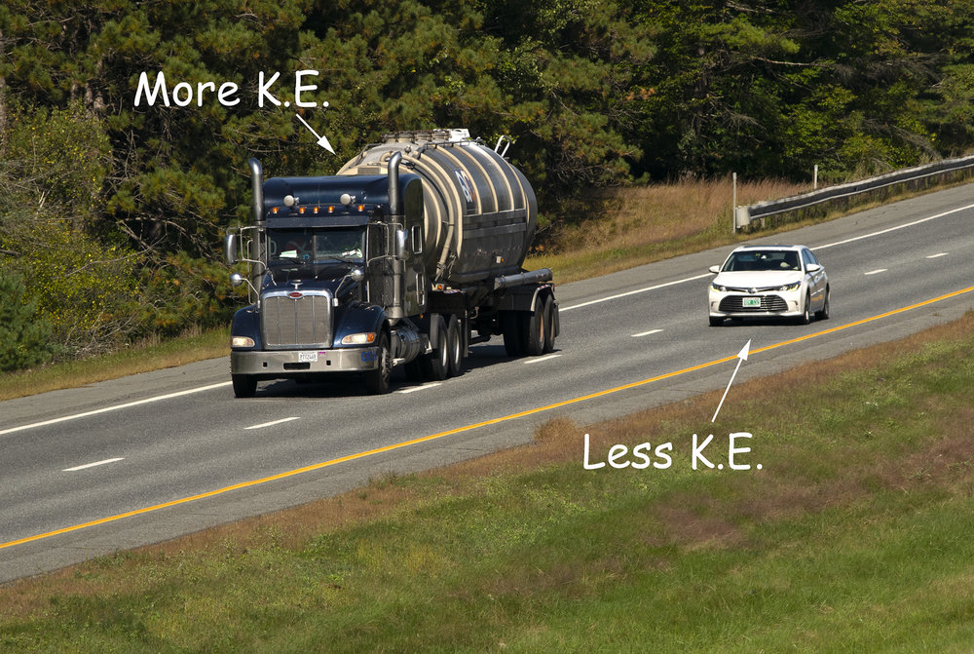
The more massive ball creates a larger dent because it has more kinetic energy than the less massive ball.
The kinetic energy of a moving object depends on its mass.
Kinetic energy increases as mass increases.

Slide 9
As mass increases , kinetic energy increases
Look at the figure ABOVE . Notice the vertical bars. These are energy bars. Energy bars show the relative amounts of energy. The more full the bar, the more energy an object has.

Slide 10
Let`s try

Slide 11
Rank them from highest to least kinetic energy

Slide 12
Kinetic Energy and Speed
Like mass, speed is a factor that affects kinetic energy.
The faster an object moves, the more kinetic energy it has. A baseball thrown at 145 kilometers per hour has more kinetic energy than a baseball thrown at 64 kilometers per hour.
All objects that have motion have kinetic energy (KE) because they are moving. However, each object’s speed helps determine the amount of kinetic energy the object has.

Slide 14
The graph above shows the proportional relationship between kinetic energy and speed. Notice that this graph is different from the graph that shows the relationship between kinetic energy and mass. Even though both are proportional relationships, they are not the same type of proportional relationship

Slide 15
When you increase the mass of an object, the kinetic energy increases by the same factor.
When you increase the speed of an object, the kinetic energy increases by the square of the factor. This is a square, nonlinear relationship.
It looks like the exponential graph above. When players throw a ball, they give the ball kinetic energy. If they throw the ball twice as fast, they quadruple its kinetic energy. This relationship can be expressed mathematically, as shown below.

Slide 16
Test yourself

Slide 17
Test yourself

Slide 18
Inspire science lesson check

